Slide 1
Write Essay in Overleaf
Zecheng Zuo
2022213434

Slide 2
Contents
1.What is Overleaf
2.Create an essay
3.LaTeX grammar
4.Templates

Slide 3
What is Overleaf
Overleaf is a cloud-based LaTeX editor used for writing, editing, and publishing scientific documents.
Overleaf provides an easy-to-use platform that allows users to create LaTeX documents directly in their web browser without needing to install LaTeX on their personal computer. Users can share their projects with collaborators, who can then make edits and comments, making the process of co-authoring documents more efficient.
Overleaf also integrates with numerous academic journals and publishing services. With a vast library of templates for various types of documents, from thesis projects to conference presentations.

Slide 4
What is Overleaf
https://cn.overleaf.com/

Slide 5
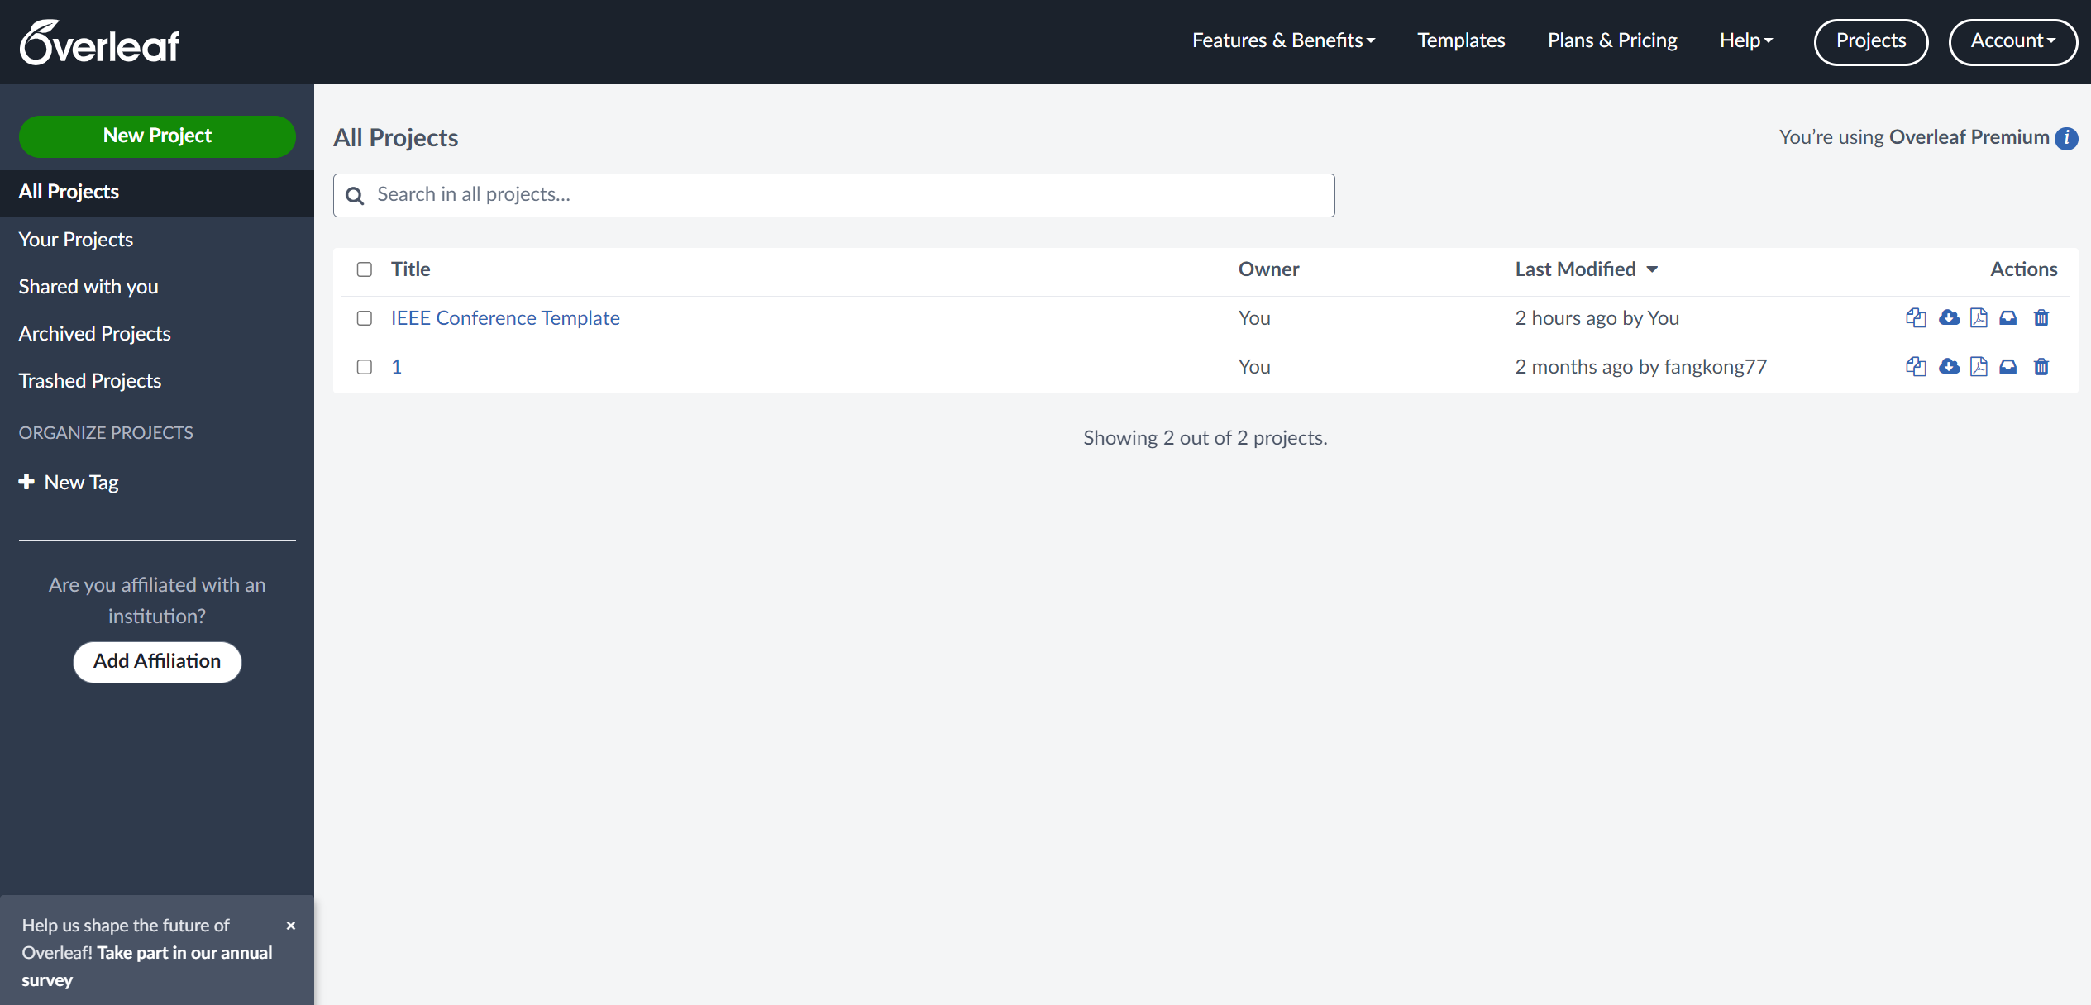
Create an essay

Slide 6
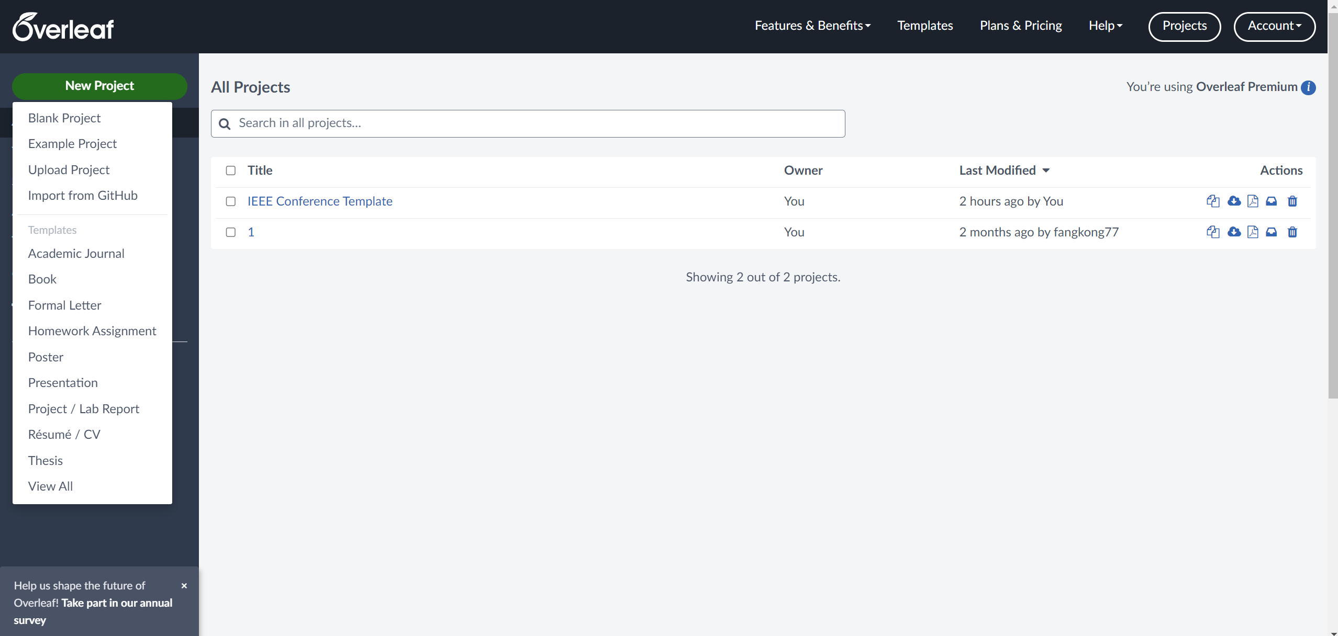
Create an essay

Slide 7
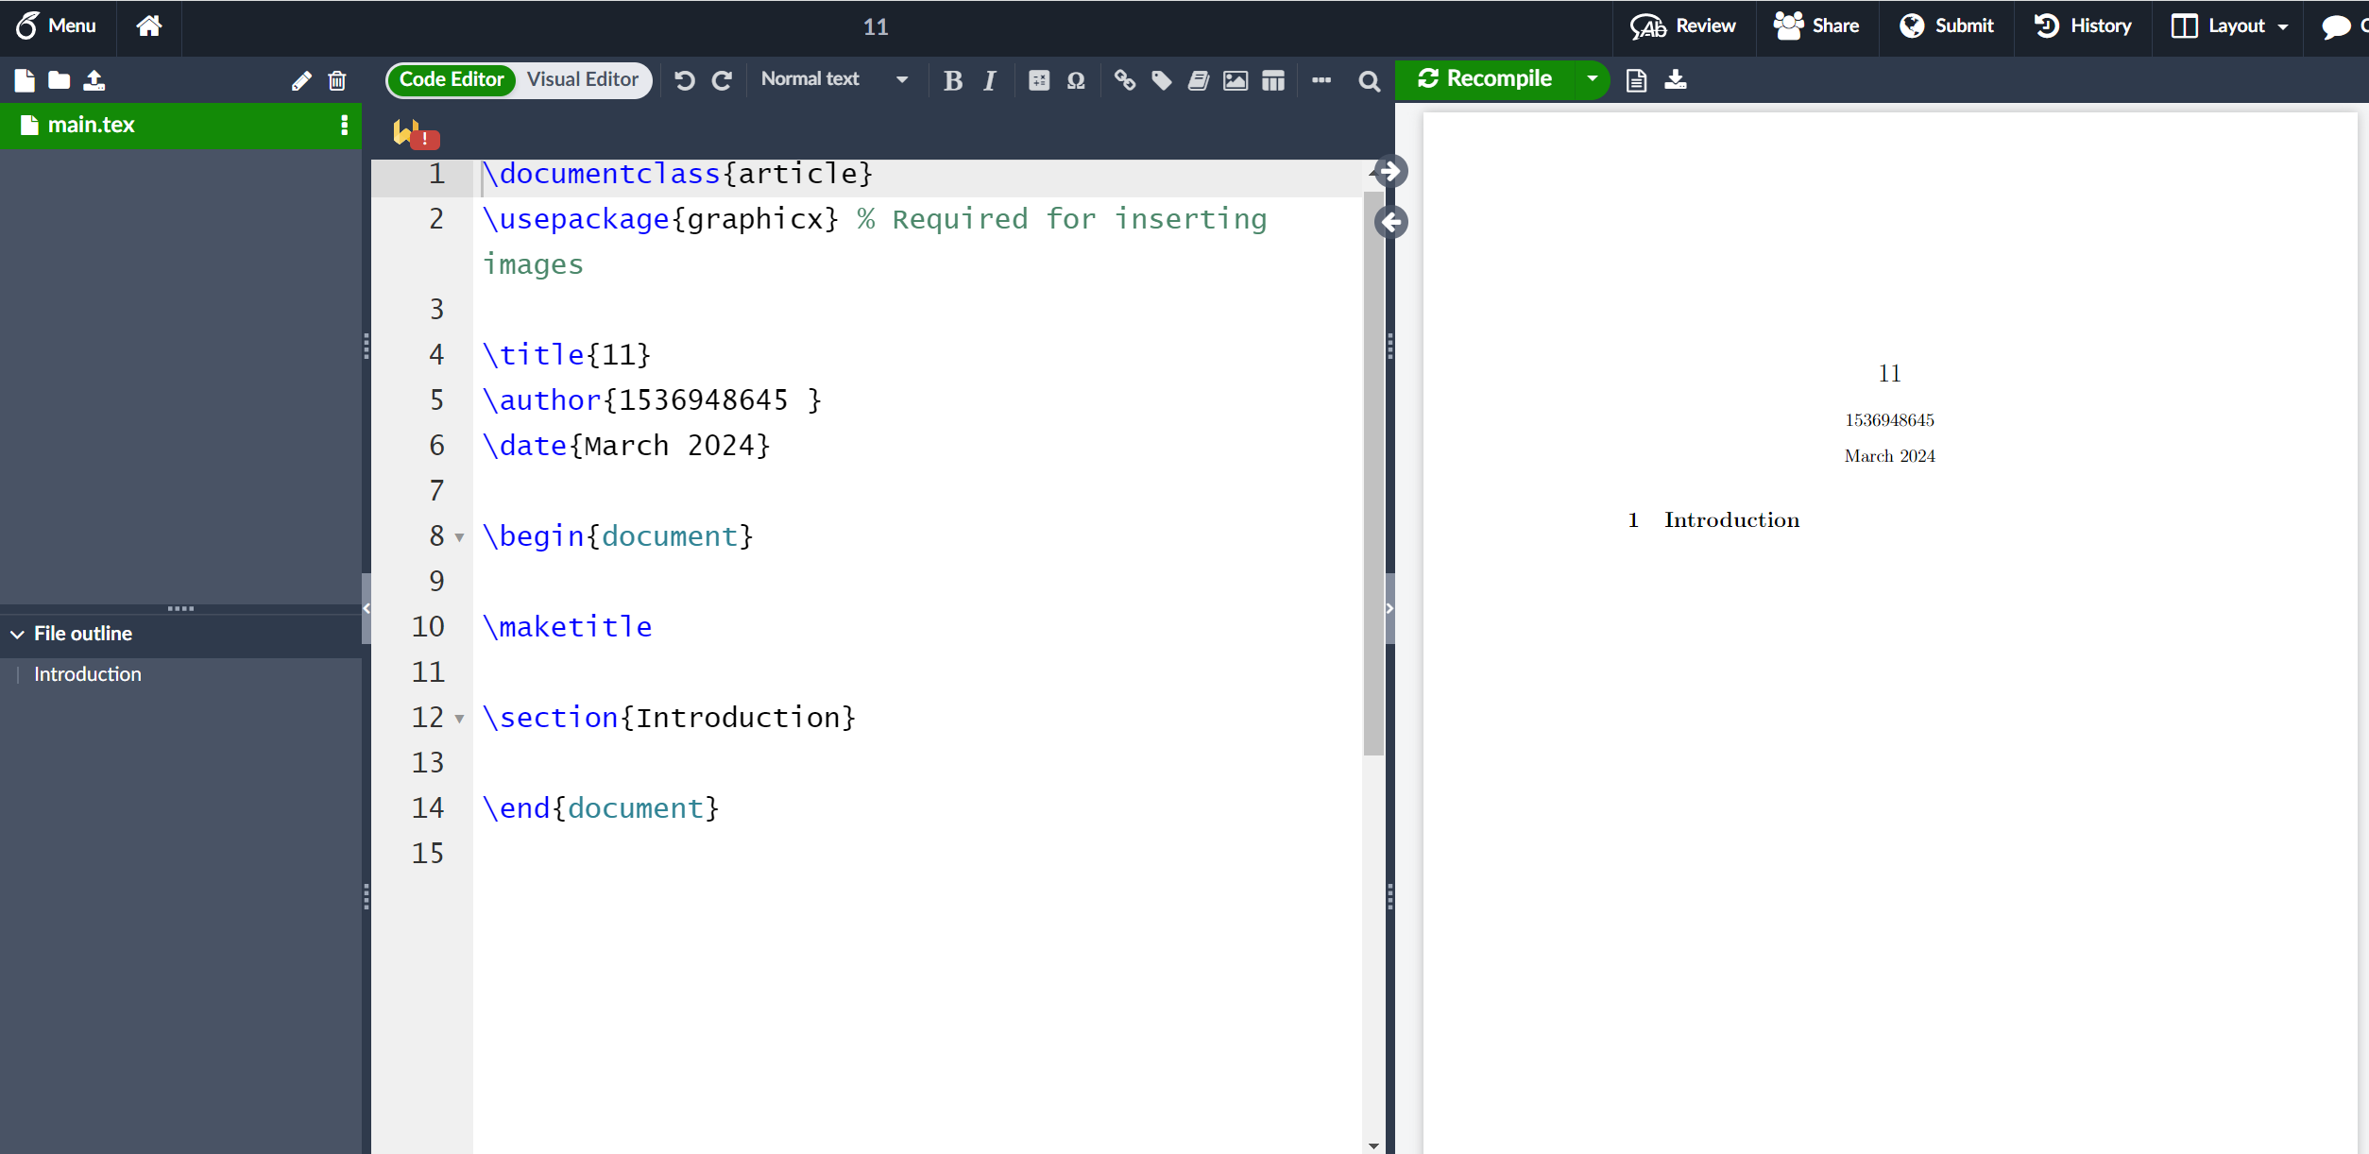
Create an essay

Slide 8
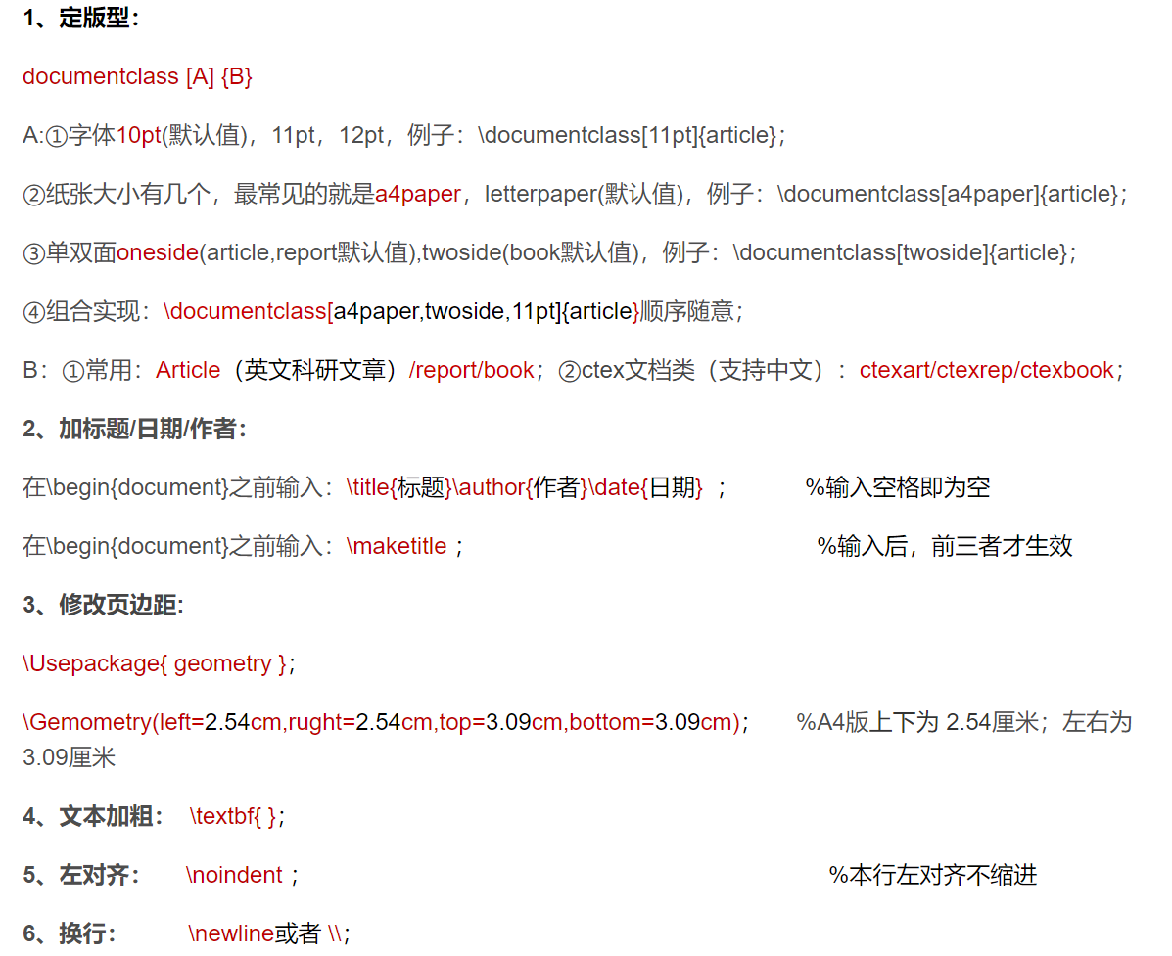
LaTeX Grammar
文本/排版：

Slide 9
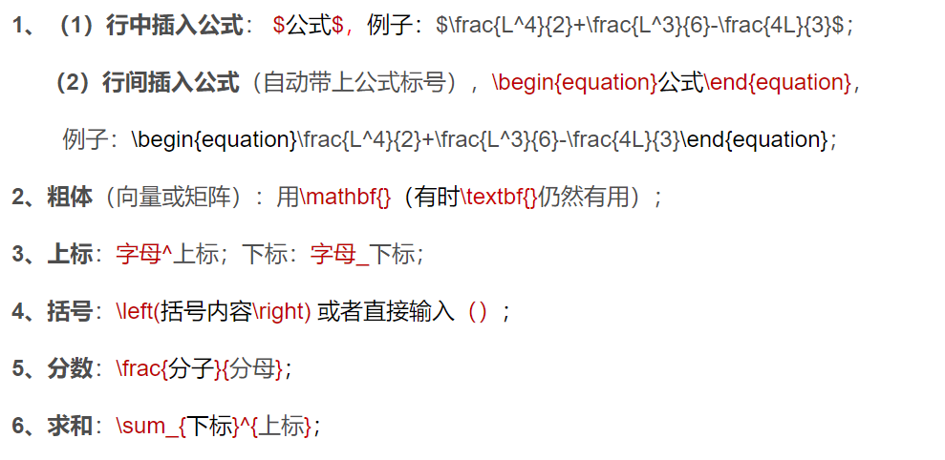
LaTeX Grammar
公式编辑:

Slide 10
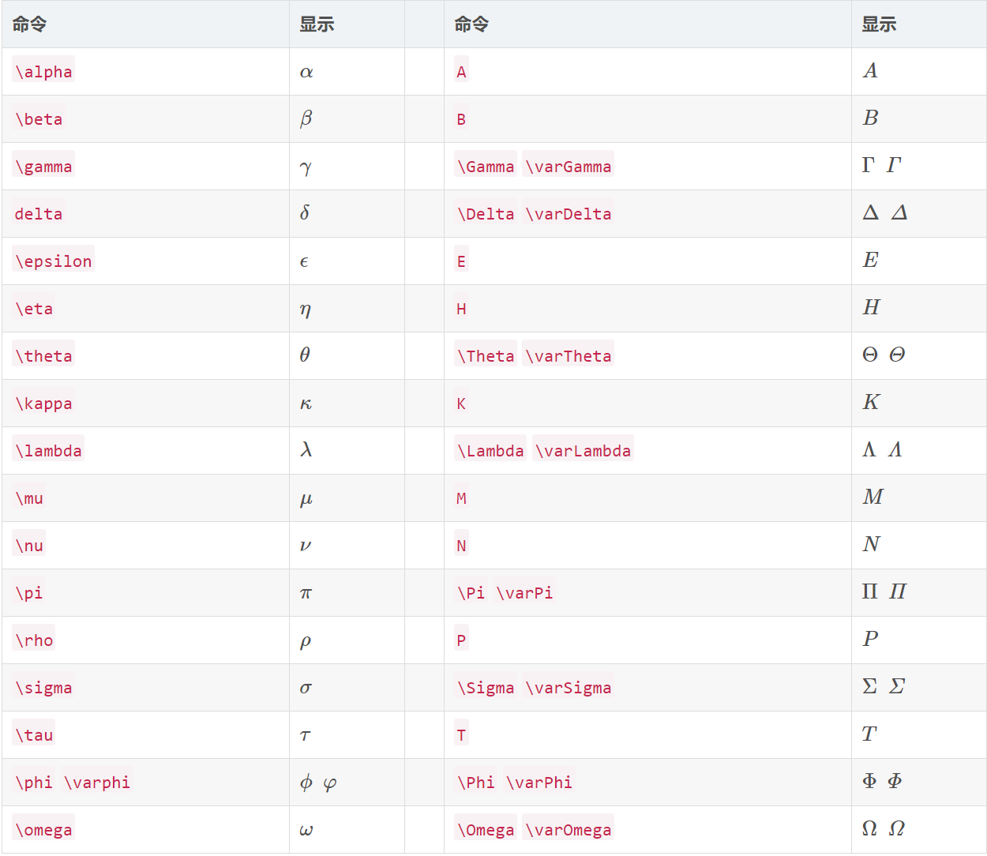
LaTeX Grammar

Slide 11
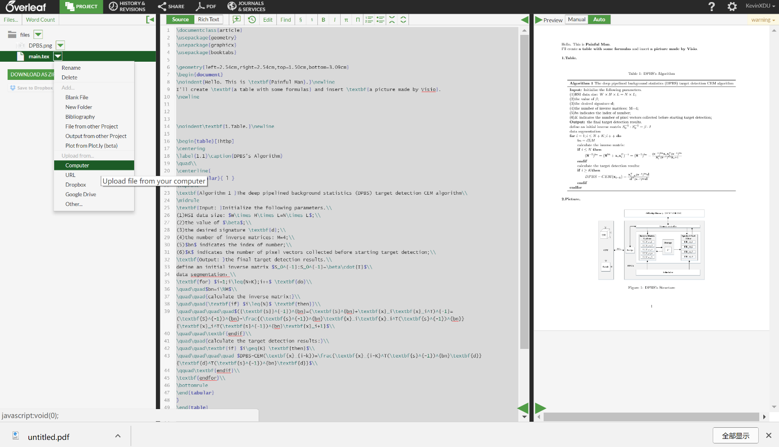
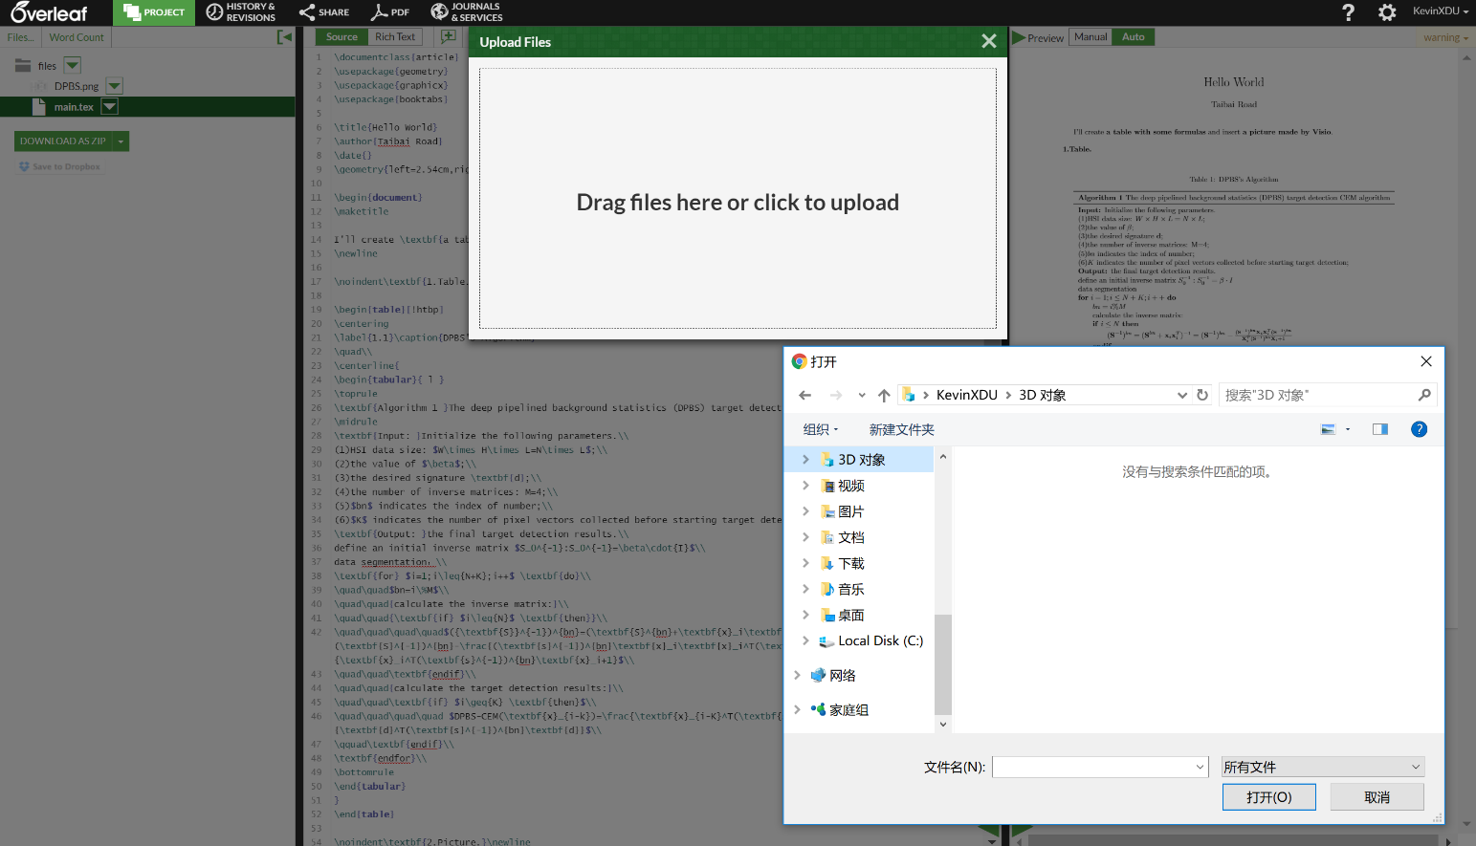
LaTeX Grammar
插入图片:
首先将需要插入的图片上传到当前编辑文件的云端库中；

Slide 12
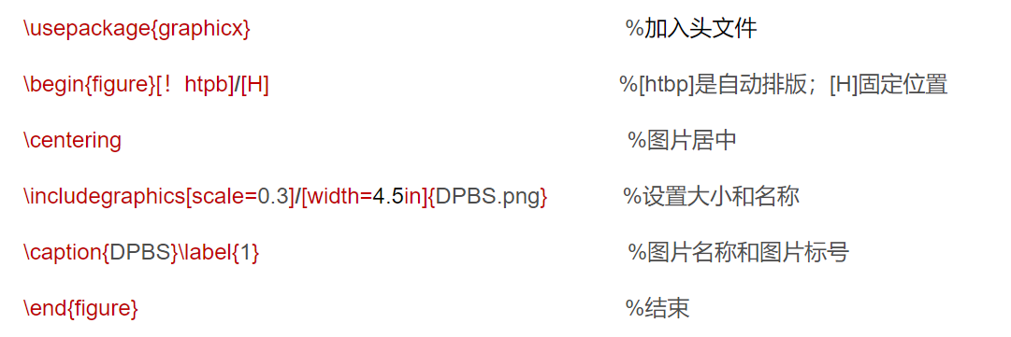
LaTeX Grammar

Slide 13
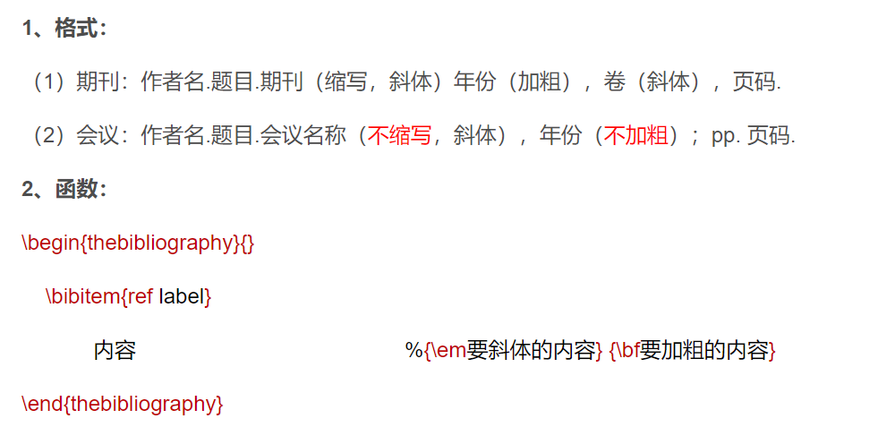
LaTeX Grammar
参考文献：

Slide 14
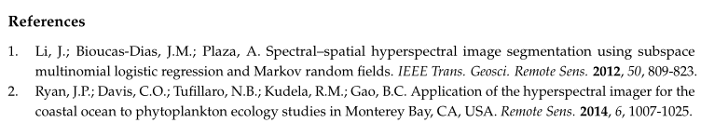
LaTeX Grammar
EX:

Slide 15
LaTeX Grammar
EX:
\begin{thebibliography}{}
\bibitem{ref 1 }
Li, J.; Bioucas-Dias, J.M.; Plaza, A. Spectral–spatial hyperspectral image segmentation using subspace multinomial
logistic regression and Markov random fields. {\em IEEE Trans. Geosci. Remote Sens.} {\bf 2012}, {\em 50}, 809-823.
\end{thebibliography}

Slide 16
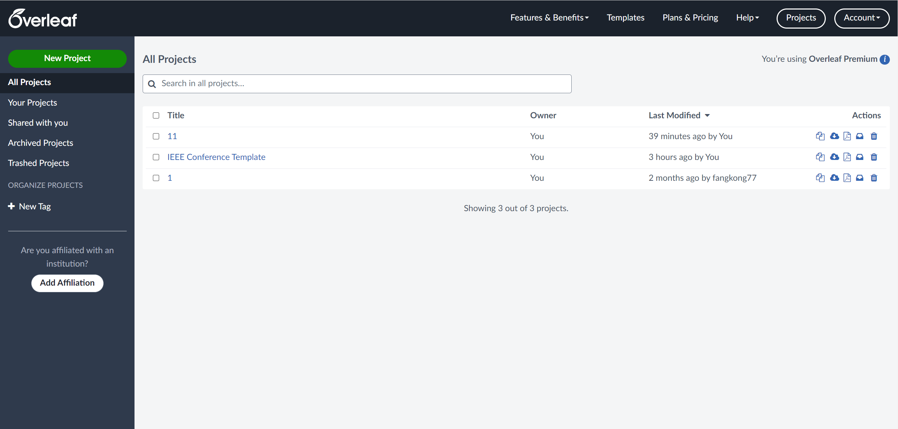
Templates

Slide 17

Templates

Slide 18
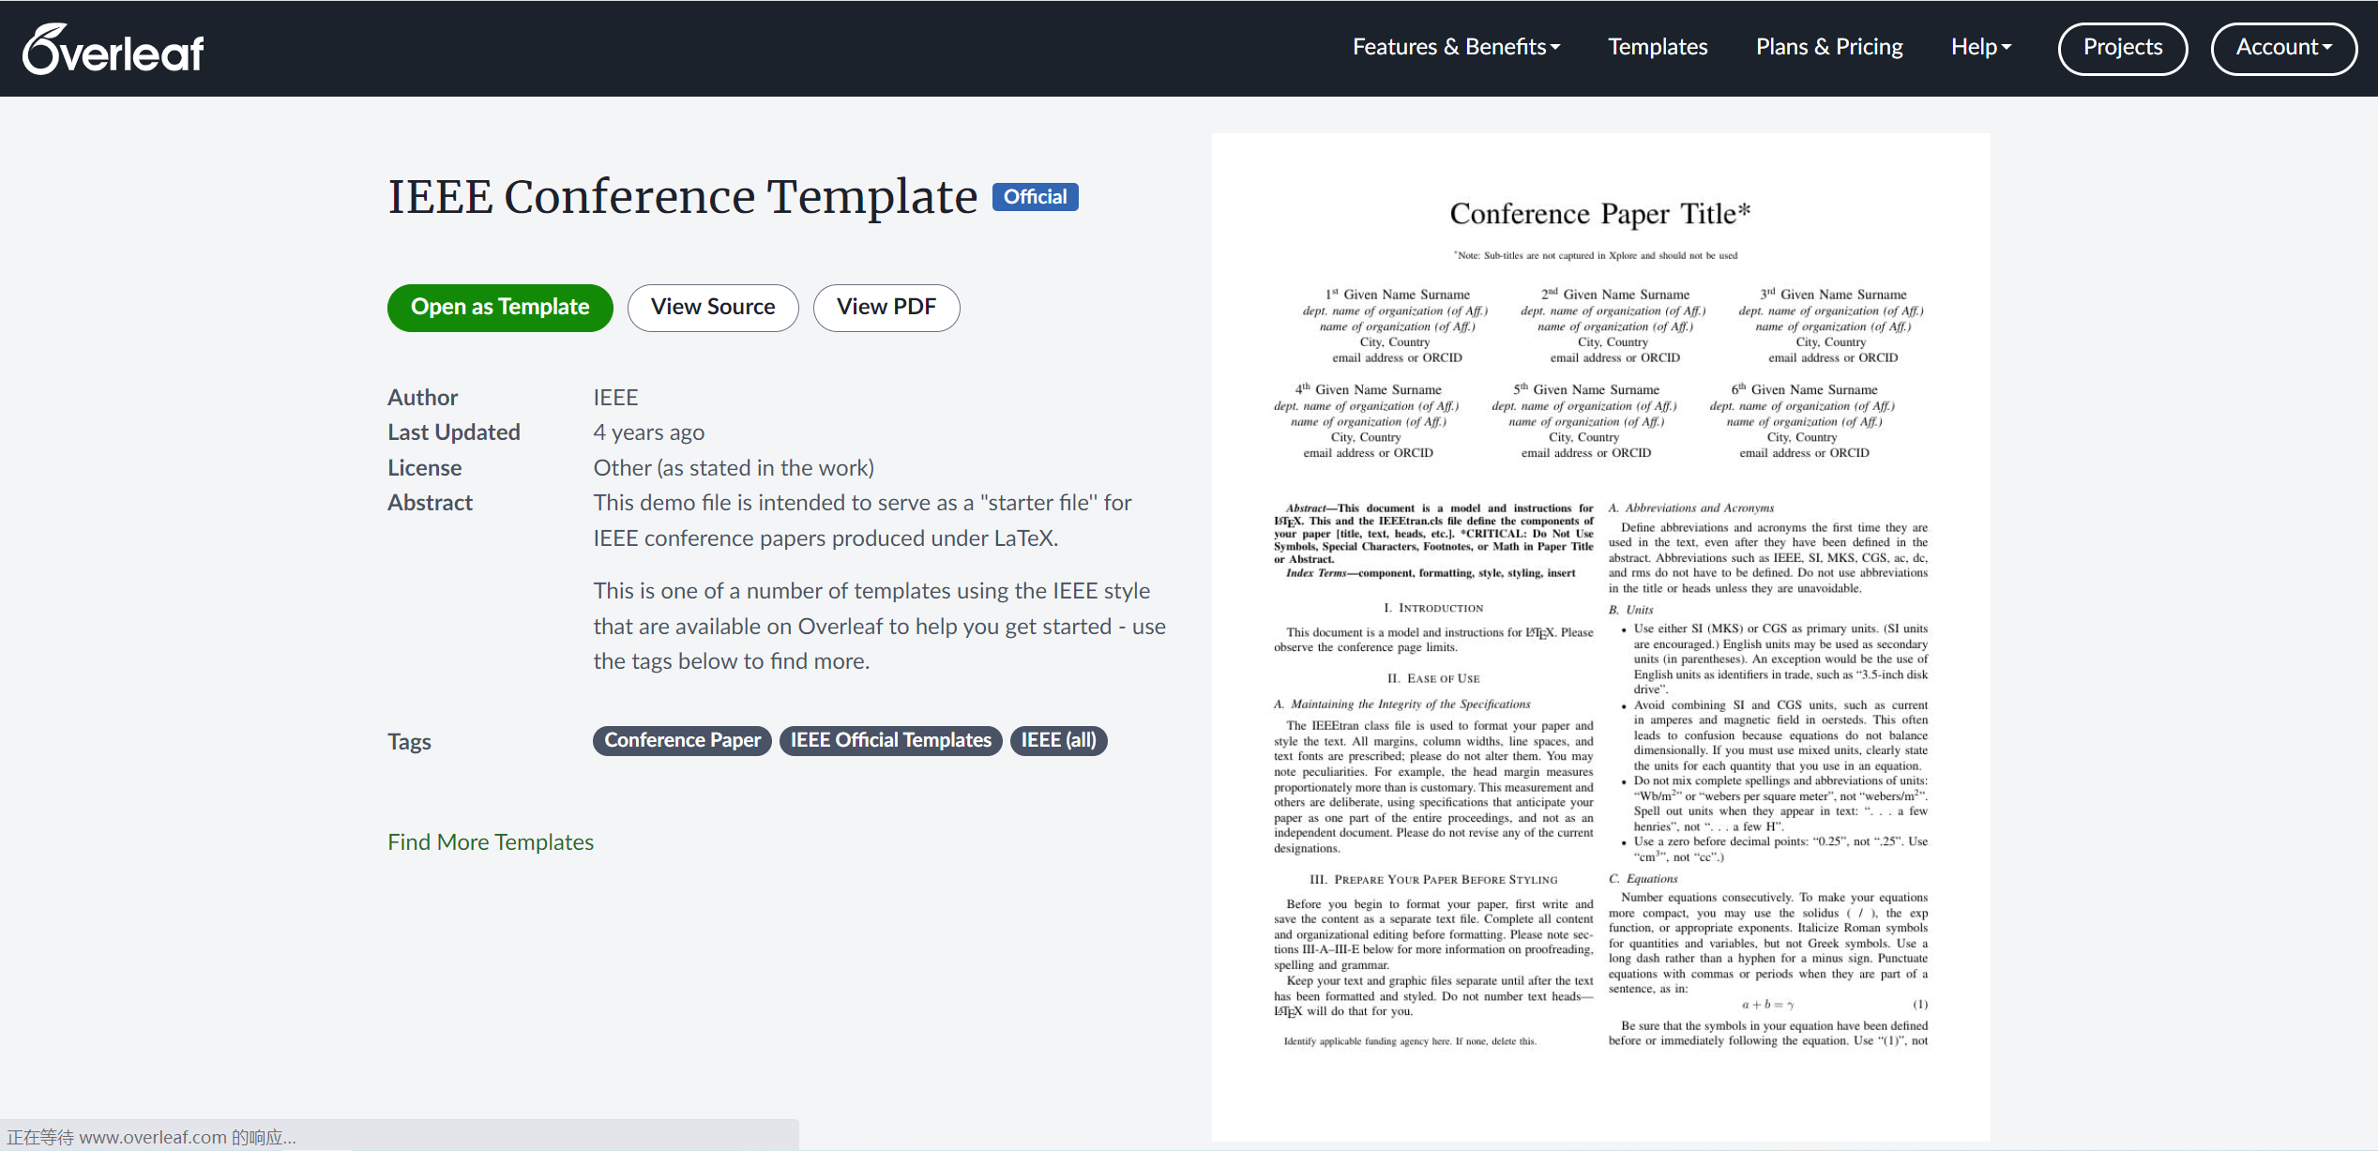
Templates
IEEE

Slide 19
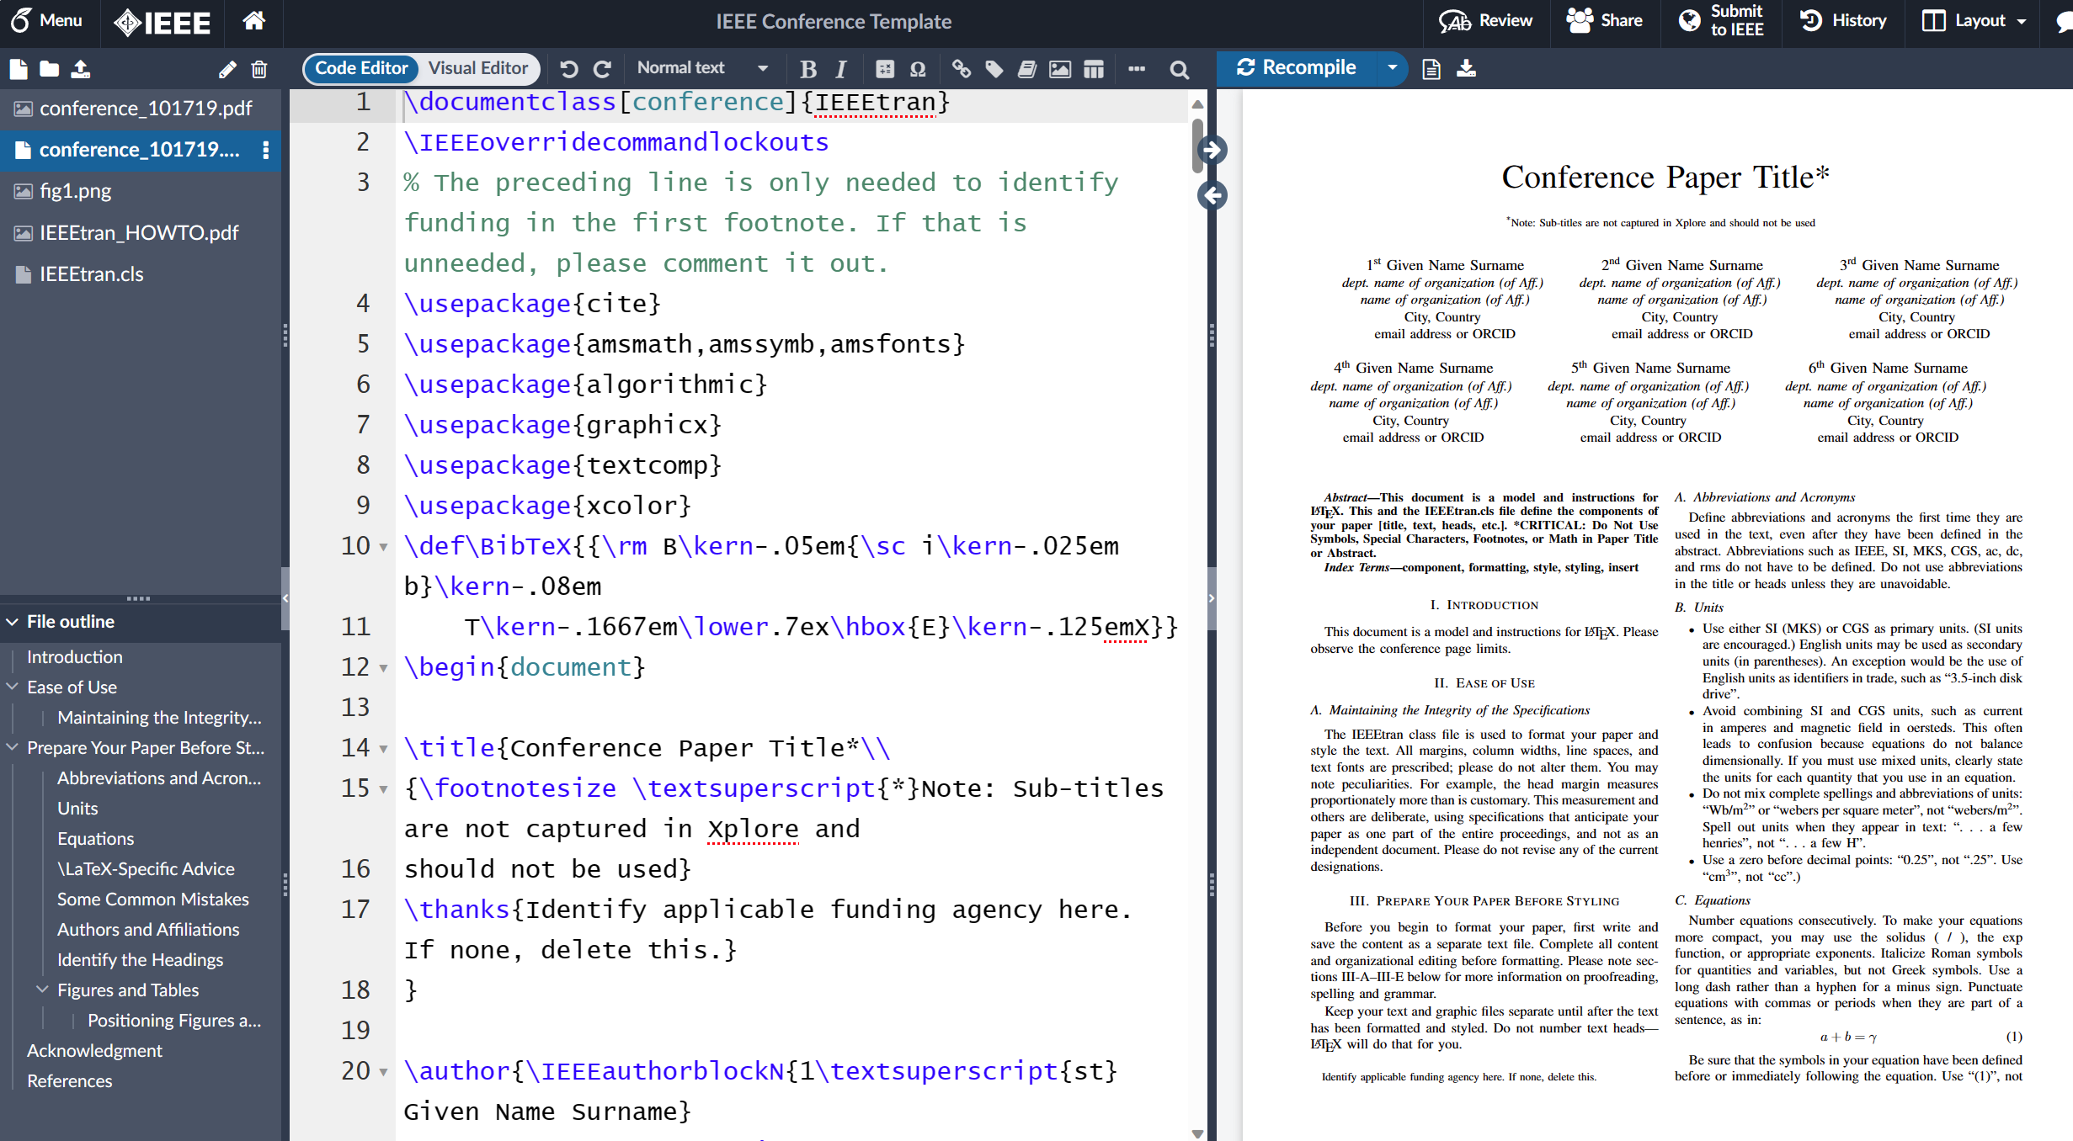
Templates

Slide 20
THANKS FOR WATCHING

